Slide 1
Jetpack Compose State Mgt

Slide 2
State in Compose
An app's "state" is any value that can change over time. This is a very broad definition and encompasses everything from a Room database to a variable in a class.
The most recent messages received in a chat app.
The user's profile photo.
The scroll position in a list of items.

Slide 3
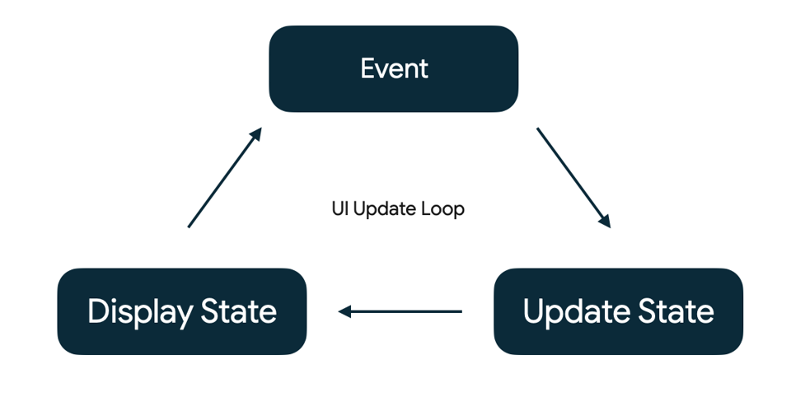
Events in Compose
Events are inputs generated from outside or inside an application, such as:
The user interacting with the UI by, for example, pressing a button.
Other factors, such as sensors sending a new value, or network responses.
Event - An event is generated by the user or another part of the program.
Update State - An event handler changes the state that is used by the UI.
Display State - The UI is updated to display the new state.

Slide 4

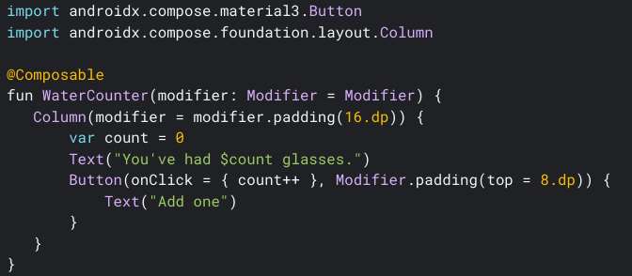
Example – Without State
Assume the following code where clicking button increases the count, but it doesn’t change the UI.
This is because we haven't told Compose that it should redraw the screen (that is, "recompose" the composable function).

Slide 5
State and composition
Compose is declarative and as such the only way to update it is by calling the same composable with new arguments.
Any time a state is updated a recomposition takes place.
Composable functions can use the remember API to store an object in memory.
A value computed by remember is stored in the Composition during initial composition, and the stored value is returned during recomposition.

Slide 6
Mutable State
Any changes to value schedules recomposition of any composable functions that read value.
There are three ways to declare a MutableState object in a composable:
val mutableState = remember { mutableStateOf(default) }
var value by remember { mutableStateOf(default) }
val (value, setValue) = remember { mutableStateOf(default) }

Slide 7
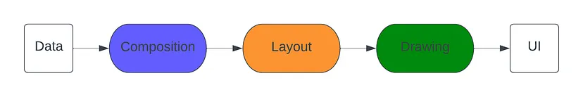
Memory in a composable function
Compose apps transform data into UI by calling composable functions
We refer to the Composition as the description of the UI built by Compose when it executes composables
If a state change happens, Compose re-executes the affected composable functions with the new state, creating an updated UI—this is called recomposition
Compose also looks at what data an individual composable needs, so that it only recomposes components whose data has changed and skips those that are not affected.

Slide 8
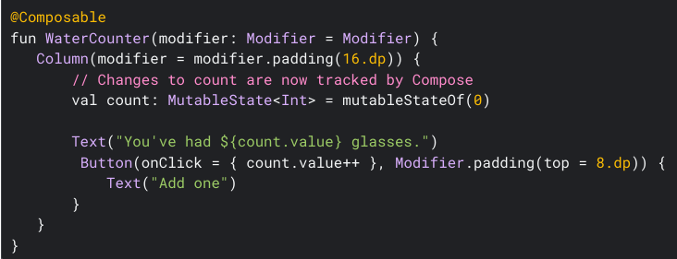
Using the State with the previous example
Lets update WaterCounter composable, so that count uses mutableStateOf API with 0 as initial value.
Even after updating the code, we can see there are no UI changes.
Scheduling recompositions is working fine. However, when a recomposition happens, the variable count is re-initialized back to 0, so we need a way to preserve this value across recompositions.

Slide 9
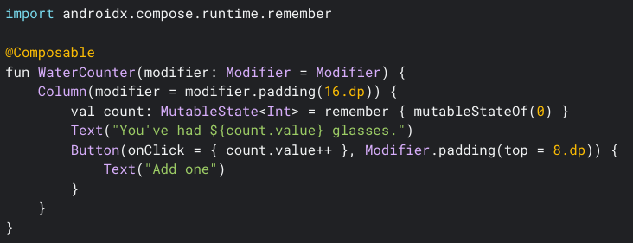
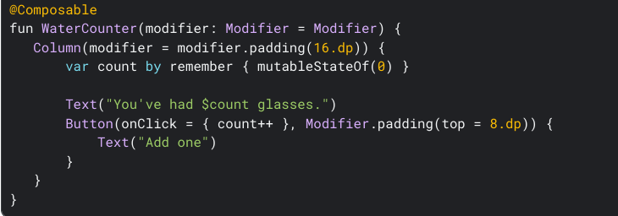
Updating Code
Let’s add the MutableState from remember

Slide 10
Activity Life Cycle
An Activity is an application component that provides a screen with which users can interact in order to do something.
As a user navigates through, out of, and back to our app, the Activity instances in our app transition through different states in their lifecycle.
Within the lifecycle callback methods, we can declare how our activity behaves when the user leaves and re-enters the activity
For example, good implementation of the lifecycle callbacks can help your app avoid the following:
Crashing if the user receives a phone call or switches to another app while using your app.
Consuming valuable system resources when the user is not actively using it.
Losing the user's progress if they leave your app and return to it at a later time.
Crashing or losing the user's progress when the screen rotates between landscape and portrait orientation.

Slide 11
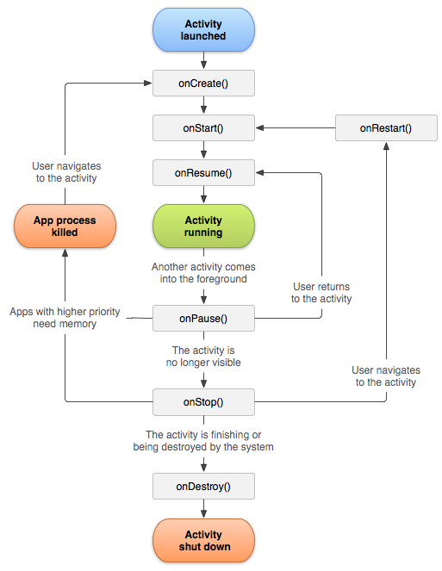
Activity Life Cycle – Contd...

Slide 12
Restore state in Compose
When the screen is rotated, the activity is recreated. Hence all the data which was stored by remember is removed.
The same happens if you change language, switch between dark and light mode, or any other configuration change that makes Android recreate the running Activity.
While remember helps you retain state across recompositions, it's not retained across configuration changes. For this, you must use rememberSaveable instead of remember.
rememberSaveable automatically saves any value that can be saved in a Bundle. For other values, you can pass in a custom saver object. For more information on Restoring state in Compose, check out the documentation.

Slide 13
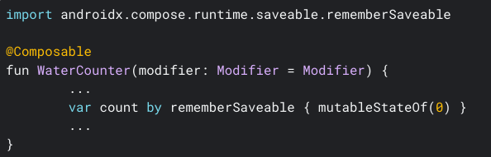
Updated code to remember the state

Slide 14
Stateful vs Stateless
A stateless composable is a composable that doesn't own any state, meaning it doesn't hold or define or modify new state.
A stateful composable is a composable that owns a piece of state that can change over time.
In real apps, having a 100% stateless composable can be difficult to achieve depending on the composable's responsibilities. You should design your composables in a way that they will own as little state as possible and allow the state to be hoisted, when it makes sense, by exposing it in the composable's API.

Slide 15
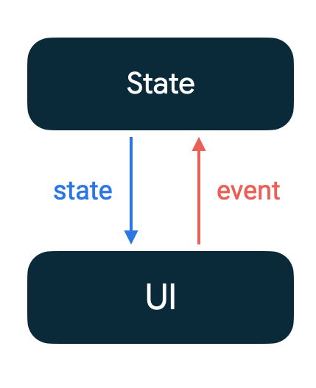
State Hoisting
State hoisting in Compose is a pattern of moving state to a composable's caller to make a composable stateless.
State hoisting is a design pattern that helps manage the state of a Composable function by lifting the state up to a higher-level function or a parent Composable.
The idea behind state hoisting is to keep the stateful logic in a single place, usually in the parent Composable, and pass the state down as a parameter to the child Composables that need it.
The general pattern for state hoisting in Jetpack Compose is to replace the state variable with two parameters:
value: T - the current value to display
onValueChange: (T) -> Unit - an event that requests the value to change with a new value T

Slide 16
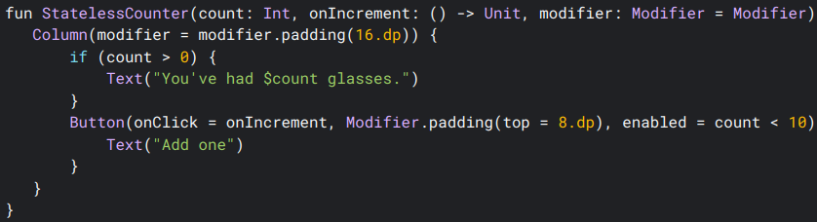
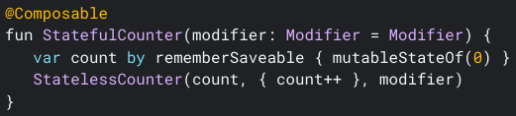
Modifying the example code
Lets divide the watercount code into two composables, stateful and stateless:

